Slide 1

Fake News Detection & Verification Tool
Presenter: Madhu T K
Guided by: Mrs. Manjuladevi
1

Slide 2

Agenda
1. Introduction
2. Problem Statement
3. Objectives
4. Technologies Used
6. Modules Overview
7. System Architecture
5. System Outcomes
8. Database Schema
8.Conclusion
9. Sample code
10. Output

Slide 3

Introduction
The Context: The rapid spread of misinformation on social media threatens public trust, safety, and democracy.
Current Limit: Manual fact-checking is slow and cannot scale in real-time to meet the volume of data.
Our Solution: An AI-powered detection system that provides automated, accurate, and fast credibility assessment.
Core Tech: This project utilizes NLP, Transformers, Deep Learning, and Fact-Checking APIs to verify claims.

Slide 4

Problem Statement
Viral Misinformation: Fake news often spreads faster than verified information.
Real-World Impact: Misinformation affects critical areas such as elections, health decisions, public safety, and the economy.
The Gap: There is currently no unified tool to classify, verify, and explain misinformation in one place.
The Need: A requirement for an automated, explainable, and scalable detection system.
4

Slide 5

Objectives
Classification: Build an AI tool to classify news as "Real," "Suspicious," or "Fake".
Verification: Enable real-time claim verification using trusted APIs.
Explainability: Provide Explainable AI (XAI) features by highlighting suspicious phrases within the text.
Usability: Support multilingual inputs and provide a user-friendly interface.

Slide 6

Technologies Used
NLP Technologies: Tokenization, Stopword removal, Lemmatization (using spaCy, NLTK).Named Entity Recognition (NER) and Dependency Parsing.
Machine Learning / Deep Learning: Transformer models (BERT, RoBERTa, DistilBERT) for high-accuracy classification.Fine-tuning pre-trained models for specific fake news datasets.
APIs & Databases: Google Fact Check Tools API
Web & Backend: Flask / FastAPI for server-side logic.
Libraries:
Pandas & NumPy: For data manipulation and numerical operations
Scikit-learn: For ML algorithms like Passive Aggressive Classifier, Logistic Regression, and Multinomial Naive Bayes

Slide 7

System Outcomes
Accuracy: The system achieves a high prediction accuracy (typically between 90% and 99%).
Scoring: Automated detection returning a probability score (0–1).
Fact-Checking: Real-time verification of specific factual claims against trusted sources.
Transparency: Explainable results with suspicious keywords highlighted for the user.
Probability Score: Provides the likelihood of the news being true or false.
Interface: An interactive dashboard to view results and analytics.

Slide 8

Modules to be Implemented / Overview
User Authentication: Handling registration, login, and JWT security.
Input Processing: Managing URL fetching and the preprocessing pipeline.
NLP & Feature Extraction: Performing NER, POS tagging, and Lemmatization.
Classification Module: Training models such as PassiveAggressiveClassifier or Logistic Regression.
Claim Verification: Integration with external Fact-checking APIs.
Explainability & Visualization: Highlighting suspicious text regions.
Web Interface: A frontend built with HTML/Bootstrap and a Flask backend.
Admin Dashboard: Managing sources and monitoring system usage.

Slide 9

Architecture Diagram
Input: User submits text URL.
Processing: Text is cleaned and tokenized.
Deep Learning: BERT Model analyzes context and semantics.
External Check: Claims are cross-referenced with Google Fact Check API.
Output: Final verdict displayed on the dashboard.
Flow: User Input → Preprocessing → NLP → Classifier → Claim Verification → Dashboard.

Slide 10

Database Schema
Users Table: Stores user credentials and profile data.
Articles Table: Stores original news content submitted for analysis.
Processed Text Table: Stores the cleaned and tokenized versions of data.
Entities Table: Stores extracted named entities (People, Organizations, Locations).
Verification Results Table: Archives the API results and final classification scores.

Slide 11

Conclusion
Summary: The project successfully demonstrates that AI can effectively distinguish between reliable and deceptive news patterns.
Impact: This tool empowers users to verify information before sharing, helping to curb the spread of misinformation.
Future Scope:
Integration with social media platforms (Twitter/Facebook bots).
Support for multiple languages (Hindi, Spanish, etc.).
Real-time URL scraping and verification.

Slide 12
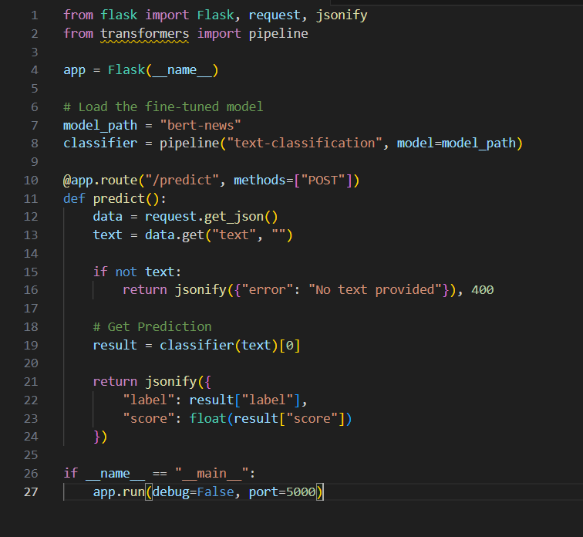
Sample Code
Backend Logic (Flask + Model)

Slide 13
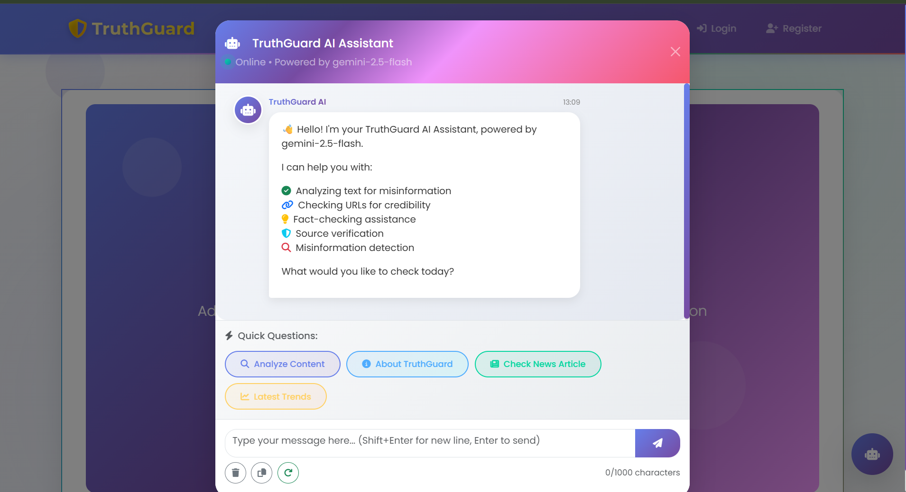
Output
User View: The web page displays a Red banner stating

Slide 14
Thank you

